Slide 1

Grooming & hygiene

Slide 2
COMPETENCIES OF FOOD SERVICE PROFESSIONALS-----------------------------------------
Competencies are the attitudes & behaviors that a person possesses. some of these are taught in childhood by parents & teachers. people may have some of these competencies as part of their nature but some can be acquired & developed through constant practice & discipline. Hospitality education builds these competencies into their curriculum in recognation of their importance in the profession.Hospitalitybeing a people’s business requires the highest numbers of competencies. These intangibles impact on guest experiences far more than the products they purchase.

Slide 3
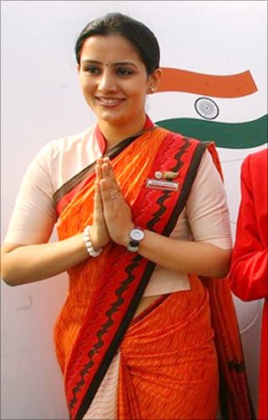

Slide 4
image
Image and Styling
“you never get a second chance to make the first impression”

Slide 5
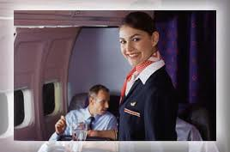

Slide 6
Here are some tips for Gentleman
Hair should be cut close.
The uniform should be well fitting, spotless, and well ironed.
Nails should be well manicured and hands absolutely clean
Guard against body odours or cheap perfumes. The market has some wonderful anti-per spirants.
Shoes should be polished and conservative in style
A close shave is necessary, stubbles of a beard or moustache could look uncomely
Bad breath could be nauseating to a guest since the waiter speaks to the guest at close proximity

Slide 7
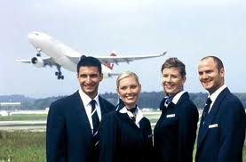

Slide 9

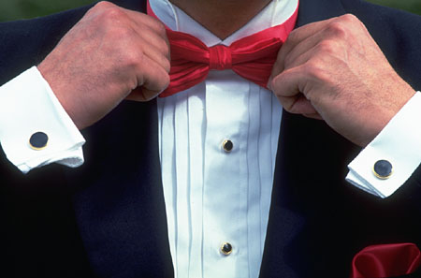
Presentation 2
Image , Styling and Grooming

Slide 10
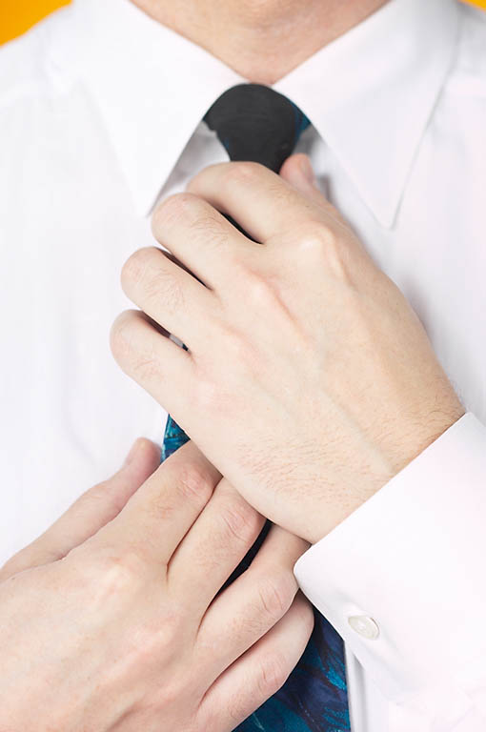
Attention to Detail
Image and Styling
Shirt
Collar
Cuffs
Tie
Length
Pattern
Style
Knots

Slide 11



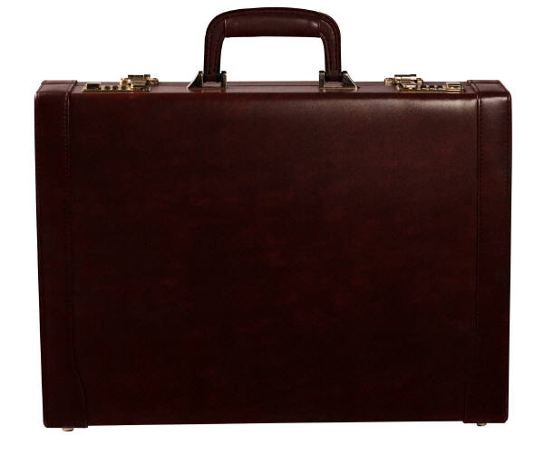
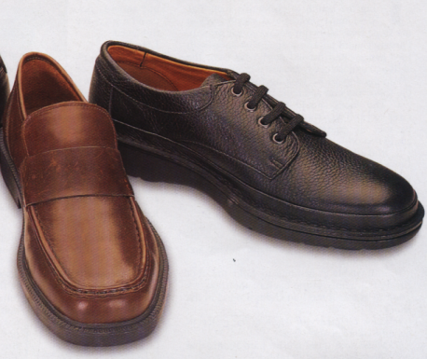
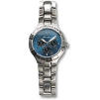

Accessories
Image and Styling

Slide 12
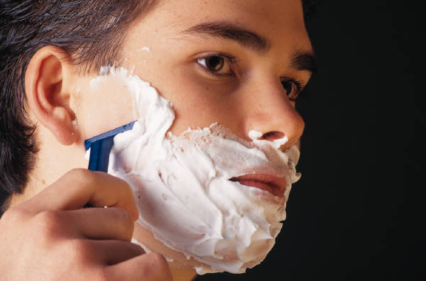
Appearance
Image and Styling

Slide 13
Some tips for a female
The apron & elastic hair band should always be clean.
Flat shoes are preferred to high heels.
Light make-up projects a professional work image.
Excessive jewellery should be avoided.
Fresh light cologne is preferable to strong ones.

Slide 14

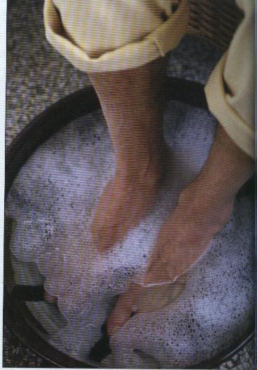

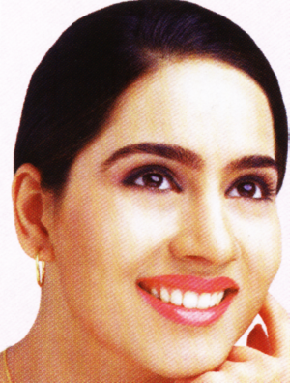
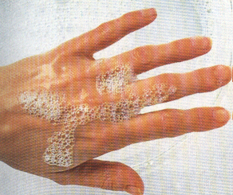
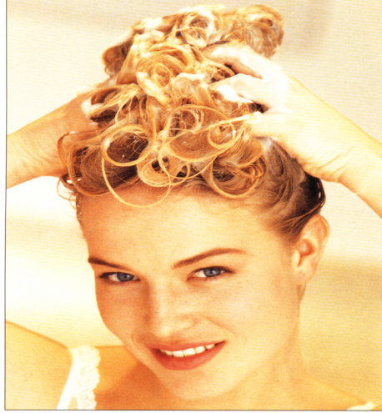
GROOMING
Image and Styling
BODY
FEET
SKIN
DENTAL
HANDS
HAIR

Slide 15
BASIC ETIQUETTES- The hotel & restaurant business is a cocktail of showmanship, diplomacy & sociability. All front line personnel are required to communicate effectively with manners & etiquette of a good host.
The basic etiquettes that a server should exhibit in a restaurant are---------------
Attend to guest as soon as they enter the restaurant using their name as powerful recognition tools. Welcome & wish them according to the time of the day.
2 Be polite using terms as ‘thank you’, ‘may I assist you’, ‘excuse me’etc.
3 Help to seat the ladies first.
4 provide extra cushions or special chairs for children.
5 Do not interrupt a guest conversation when speaking to them.

Slide 16
6.Do not overhear conversation.
7.Avoid mannerism such as touching the hair, scratching oneself etc.
8.Stand erect at all times. A gentle bow at the times of service is permissible.
9.Remember a guest’s special dish & ascertain whether he\she would like to order it again or not. Guest get impressed by such enquiries.
10.Be attentive to guest calls. sometimes gestures such as raised eyebrow or a nod of the head should be adequate for the server to get the message.

Slide 17
11.Talk softly.
12.Light guest cigarettes.{check the restaurant’s smoking policy}
13.Avoid arguments.
14.Carry pen in the trouser pockets & not behind the ears or clipped in front of the jacket.
15.Desist from chewing gum
16.present the bill to the host in a folder.

Slide 18
17. Avoid soliciting for tips. Remove tips after guest have left.
18 Always thank the guest.
19.Enter & leave the restaurant through the service door only.

Slide 19
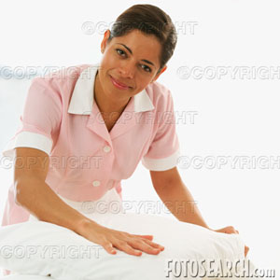
Service with smile
All the time
Notes:
Put yourself in the guest’s shoes

Slide 20
COURTSEY------------------------------------
Guest entering the restaurant must be received by the hostess or the supervisor in a cordial manner & led to a seat. Help guest to be seated.
Address guest by name as it gives recognition. Pronounce names correctly.
Guest must be asked prior to seating whether the table that they have been allotted is comfortable or not.
When approaching a guest use words like “may I assist you” or “may I be of assistance”
Let guest take time to select their menu. after a while approach them saying “are you ready to order sir\madam.”

Slide 21
6. Guest should never be hustled .Let them finish their drink before asking for their food order especially in the evenings. During lunch time, people are on tight schedules so the server must recognise this needs by providing quick service.
7.If a guest says his food or drink isn't right, the waiter should not argue but listen to the complaint,apologise by saying ‘I am sorry. please let me replace it or do you prefer something else?’
8.In case a waiter is busy & cannot attend to a guest at once, the server should inform the guest that he\she will attend shortly.
9.Always present the cheque without delay.To close a service say, “Is there anything else I can get for you?”
10.Always thank the guest.

Slide 22
SEQUENCE OF SERVICE & STANDARD POLITE PHARSES FOR RESTAURANT STAFF-----------------
RECEVING GUEST-----’Good morning\afternoon\evening Mr.\Mrs. ‘Do u have a reservation sir\madam?{If possible note guest’s name on the diary to facilitate paging & for increasing guest history database.
LEADING GUESTS TO THE TABLE----’This way please’
SEATING THE GUESTS----’Allow me sir\madam {partly pull out the chair} Unfold the napkin.
CHECKING FOR WATER----’Would you like to have mineral water or regular water’?

Slide 23
PRESENTING THE DRINKS MENU---’Would you care for a drink sir\madam? If yes-present the beverage list.
TAKING THE DRINKS ORDER----’May I have your order sir\madam?’
For spirits always check for mixers. Would you like it with soda & ice sir?
SERVING DRINKS----Ensure you announce what you are serving. “sweet lime juice at room temperature madam.
After the service say-Enjoy your drink sir\madam.
PRESENTING FOOD MENU----”Our dinner menu madam\sir”
{Ensure that you inform the guests about non availability of the items & specialty of the day if any at this stage}

Slide 24
TAKING FOOD ORDER----”May I have your order sir\madam or “would you like to order sir\madam?
{Each time the guest orders for a dish, acknowledge by simply saying “certainly sir\madam”}
Always maintain good posture & a minimum distance of two feet while speaking to the guest.
Remember not to remark negatively about any dish on the menu.
Give two options if the guests for ur recommendation.
Always note down the order
If you are not sure about any detail, do not give wrong information. check with the chef \supervisor & revert to the guest.
Always repeat the order to the guest.

Slide 25
SERVING FOOD-Make sure you announce what you are serving.
“spaghetti with cheese sauce sir\madam”
{Remember the order placed by each guest, & serve the right dish to each guest without asking}
CHECKING FOR REPEAT DRINKS ORDER-”Would you like to have another glass of Jim beam?”
{Recommend another drink when the glass is 3\4th empty.
CHECKING THE FOOD QUALITY-”I hope you are enjoying your dinner\lunch\breakfast sir\madam.”

Slide 26
CLEARING PLATES---’Excuse me madam\sir.' If a guest has left most of his \her food always inquire ‘I hope you liked the pasta, sir\madam’
{If the guest expresses dissatisfaction always inform your supervisor.}
CRUMBING & PLACING TOOTHPICKS ON THE TABLE----”Please allow me sir\madam.
{Crumb the table first,& then place the toothpicks}
TAKING DESSERT ORDER—Same as taking food order.
SERVING TEA\COFFEE-----”Would you like some milk sir\madam”
{Make sure you have the guest’s attention while pouring milk}

Slide 27
PRESENTING THE BILL----”I hope you enjoyed your meal sir\madam”
Many guest are impatient towards the end of the meal. Prepare the bill & keep it ready whenever possible.
check the bill carefully
present the bill on request..
SEEING THE GUEST OFF----”Thank you Mr.{guest name},Have a nice day\good night.{We hope to see you again}
Use “WE", as you represent the entire restaurant team.

Slide 28
When you approach a guest who is busy with something or talking to someone else, get his attention by saying “EXCUSE ME SIR\MADAM”
Every request or order that can be performed should be acknowledged by saying “CERTAINLY SIR\MADAM”
Every time a guest thanks you, acknowledge by saying “MY PLEASURE SIR\MADAM\
4. SMILE & ENTHUSIASM increase the value of your interactions with guests immensely.

Slide 29
TYPES OF SERVICE-----The type of service of an establishment depends on a number of factors like the type of catering establishment, type of clientle,time available for a meal, type of menu,& the cost of the meal served etc.Some basic principles apply to all types of service & every food & beverage professional must practice them. These principles are as follows-
When food is served at the table from a dish to a guest’s plate, it is done from the left.
When food is pre plated, the service to the guest is done from the right.
All beverages are served from the right.
Soups are served from the right unless poured from a soup tureen in to the soup plate.{in which case it is done from the LEFT}

Slide 30
5.Ladies are always served first.
6.Soiled plated are always cleared from the table from the RIGHT.
7.Fresh cutlery & crockery is always served from the RIGHT.
8.Never reach across the guest.{All equipment on the right of the guest must be cleared from the right & that on the left from the left}

Slide 32
UNIT-2--------PREPARING THE RESTAURANT
MISE EN PLACE
MISE EN SCENE
INTRODUCTION-A well organized restaurant impresses the guest on their arrival & helps the wait staff to extend the service efficiently. Food service staff should ensure that the tables are set up with clean tableware according to the menu on offer. Sideboards carry necessary items that are required during the service,& pantry is well equipped so as to prevent any confusion & work stress during the work.

Slide 33
All the activities carried out before the arrival of guests can be grouped into mise en scene & mise en place.
MISE EN SCENE-Refers to the activities related to keeping the area clean, presentable,& comfortable for the guest.
MISE EN PLACE-Refers to keeping everything ready for service.

Slide 34
MISE EN SCENE-The activities of mise en scene include----
Opening windows & drawing curtains.
Cleaning the area & vacuum cleaning the carpet.
Checking if all the electric gadgets are working properly.
Creating an ambience that is comfortable & relaxing for the customers
Freshen the Restaurant, in order to remove any kind of stale smell of food or smoke from the room. This can be done either by opening the Restaurant widow or by air circulation in the room.

Slide 35
Dusting furniture, fixtures.
Polishing mirrored surfaces
changing fused bulbs
Putting all furniture & other items in its respective position in symmetrical order
Checking plants & flowers in the restaurant or any other decoration that might be.
Creating the right ambience for the restaurant is essential for customer satisfaction.Music,lighting,ventilation & air conditioning are important factors which must be checked while preparing the service area.

Slide 36
MISE EN PLACE-The term mise en place in a Restaurant refers to all the duties that are carried out to keep the service area ready for the guests. The server has to ensure that his station is adequately equipped with the service ware for service..
Polishing wooden furniture
Placing periodicals newspapers,& menu cards
setting up the sideboard with necessary items that are required during service is a part of mise en place activities. The staff should ensure that the sideboard has everything.
The staff should ensure that tables are dusted properly.
The staff should ensure that cutlery is wiped & then stored in the sideboard.

Slide 37
All the required things should be kept ready for service to ensure that customers are attended to promptly when they are dining & they leave the place with complete satisfaction.
All items of crockery are checked for dirt ,cracks & chips. If any piece is dirty ,it should be sent for rewashing. Chipped & cracked crockery should be recorded & withdrawn from usage.
The staff should ensure that linen is collected from housekeeping department\laundry & stored properly in the linen cupboard\linen room.
The linen is free from stains
Napkins should be neatly folded.

Slide 38
TYPES OF SERVICE-
AMERICAN SERVICE-This is a style of service from the US known as plated service. Coffee shops which are informal restaurants adopt this style of service. This method ensures quick service & clearance as the Americans believe in the least amount of fuss.
Its features are-
The cook assembles a complete meal in a guest plate in the kitchen. It consists of a main dish accompanied with vegetables, potatoes{Mashed, fried or sautéed}.The portion is pre determined in the kitchen & the accompaniments served in the plate balance the entire presentation in terms of nutrition & color.
The plated food is brought by the server & placed from the RHS of the guest.

Slide 39
The server may keep food covers to keep the food warm till it reaches to the guest.
He removes the cover when the food is placed before the guest.
The necessary cutlery such as knife & fork is arranged on the table before each seat with common bread basket,butter dish, salt & pepper.
Up market Restaurant may keep a show plate in front of the guest & place the food plate on top of it.
SILVER SERVICE-This service is given name as all the cutlery, service dishes, service forks, & spoons are made of silver. The food presentation is elaborate to heighten the dining experience. In this service-
The table is set for Hors d’oeuvre,Potage,Main course & dessert.
The food is then taken to each guest & served into the guest plate from the Left of the guest with a service spoon & fork.

Slide 40
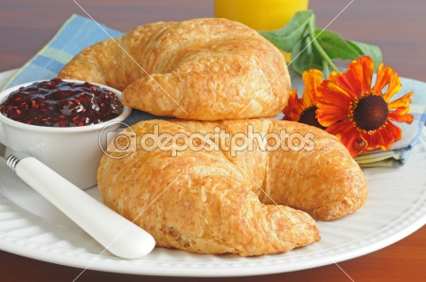

Slide 41
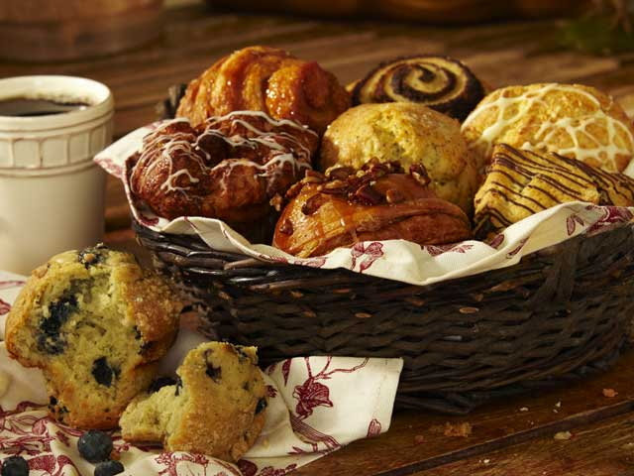

Slide 42
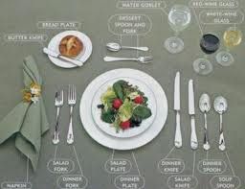

Slide 43
Styles of food service–
There are many ways in which food & Beverages are served to the guest in the catering industry.This may range from full silver service in a fine dining restaurant,where the dishes are served at the tables by staff with service spoon & fork,to a self service cafeteria where guests collect their own food from the counter.The food & beverage service styles can be broadly classified into three main groups-
Waiter service
Self-Service
Assisted Service

Slide 44
1.Waiter service-In this method of service food & beverages are served to guests by waiters at the guest’s plate.It may be at a table in a restaurant, in a hotel room, on a flight, in a hospital & so on.This service is further classified into the following--------
English service-It is also known as Silver service.In this method dishes are presented & transferred to the guest;s plate using service spoon & fork from the LHS of the guest while beverages are served from the RHS.It is regarded as Formal service.This kind of service is implemented in upscale restaurant.

Slide 45
Advantages-
Personalised service
Guest satsfaction
F&B staff have scope to exhibit their service skills
No plate wastage
Limitations-
Calls for high level of service skills,hence more labour cost
More staff required
Low seat turnover
Slow service

Slide 46
French service-This is also known as family service.In france this service is found in family pensions & banquets where the dish is presented to each guest from the LHS to help themselves.For a small party of 2 or 3 guests dishes ordered by them are placed on the table with service implements & plates for the guest to help themselves.For larger parties of more then 4 guests a side table or trolley can be used.The waiter keeps plates service tools & dishes on side board \trolley.he \she places plates at guest’s covers &then present dishes with service gear to each guest from the LHS to help themselves.Alternatively all dishes may be placed on the table &the host may serve all his guests at the table.Alternatively all dishes may be placed on the table & the host may serve all his guest at the table 1st or assist them in service & serve himself finally.

Slide 47
This method is widely practiced in ethnic restaurants ,especially in Chinese 7 Indian restaurants. Indian breads & accompanying dishes are kept on the table for guests to help themselves. If assistance is required the waiter may help the guests in passing & serving the dish.
Advantages-
Service skills not required
Low labour cost
Seat turnover is more compared to silver service
Quick service
No plate westage
Limitations-
Service staff will not be able to show their service skills
Food may be go cold
Guest may spill or burn
Need more area on the table
Guest may feel neglected

Slide 48
Russian service-This is a very elaborate service & may also be termed as side board service .In this style large joints, roast poultry, whole fish & so on, that have elaborate garnish,are neatly arranged on a platter, presented to the host ,taken back to the side board ,carved, portioned, & served to the guests with service spoon & fork. After service dishes are kept on hot plate in the sideboard to keep them warm. Each course is served from the sideboard. This service is not practised in recent times.
Advantages-
High level of guest satisfaction
Personalized service
Staff have scope to show their service skills
Good presentation
Limitations-
Calls for highly skilled staff, hence higher labor cost
More wait staff required
Low seat turnover,as time taken for service is more

Slide 49
Gueridon service-This is also termed as trolley service. In this style of service dishes are prepared, carved ,dressed or flambéed on a trolley in front of the guest & served with service spoon & fork. It is a very effective tool for merchandising. Restaurants may have trolleys specially constructed for various jobs such as carving, flambéing & presentation.The design of a trolley varies according to its purpose.Carving trolley, flambe trolley, Hors d’ oeuvre varies trolley, cheese trolley, & liqueur trolley are some of the trolleys found in restaurants offering gueridon service.This type of service is practised in luxury ,upmarket restaurants.
Advantages-
Highly personalized service
High level of guest satisfaction as the dishes are prepared, carved or flambéed in front of their presence
Wait staff can exhibit their culinary, carving & service skills
High average spending power {high rev.cover}
Limitations-
Slow service
Low seat turn over
Expensive style of service
Chance sof accidents are more
More investment on service equipment
Cooking in the service area may leave odour

Slide 50
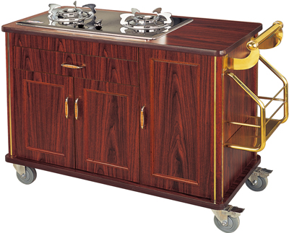

Slide 51
